Slide 1
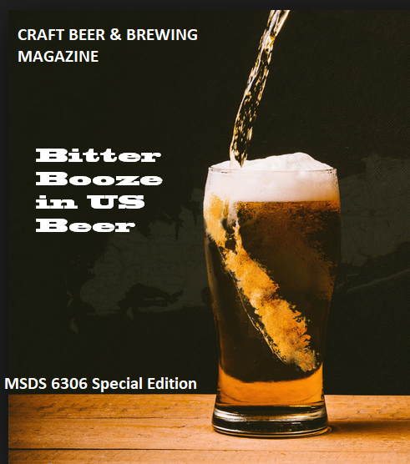
US Craft Beer Analysis Bitter Booze in US beer
Nathan Wall, Muthu Palani & Nathan Lara February 27, 2018

Slide 2
Background
Craft Beer & Brewing Magazine would like to understand the correlation between alcohol volume and bitterness in the US Craft Beer for a cover story “Bitter Booze in US beer”
Analysis should also address the following questions & must be from the given Beer and Breweries details
Plots & Charts if required
State any missing information
Summary statistics of alcohol volume
How many breweries are present in each state?
Median alcohol content and international bitterness unit for each state
US States with maximum alcoholic (ABV) beer & most bitter (IBU) beer?

Slide 3
Beer Stats – 2410 Craft Beers & 551 breweries from 384 cities*
Colorado has the highest number of breweries - 47
Followed by California with 39 breweries
Washington DC, North Dakota, South Dakota and West Virginia, all have one brewery
* Data Quality & Assumptions are documented in Slide7

Slide 4
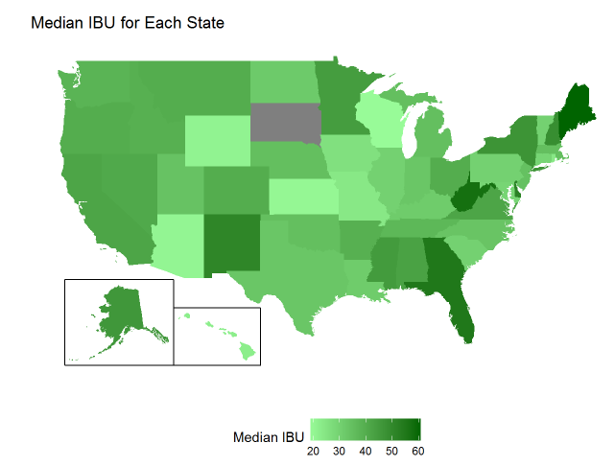
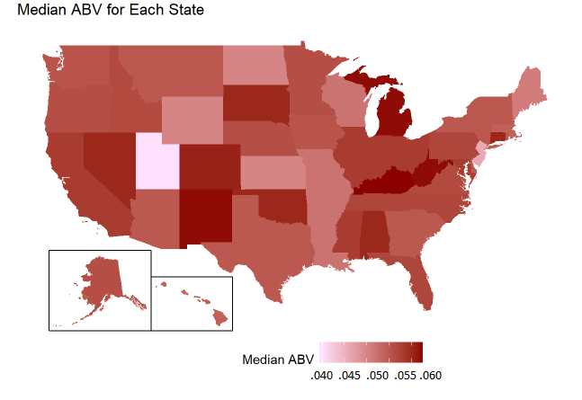
Beer Stats – Geographical Comparisons

Slide 5
Beer Stats – Min Max Median
Breweries from Maine (ME) have a median IBU in beers of 61 ppm isohumlone.
Colorado boasts the beer with the maximum alcohol by volume (12.8%) Standard Budweiser has an ABV of 5% *alcohol by volume beer (Lee Hill Series Vol. 5 - Belgian Style Quadrupel Ale)
Astoria Bitter Bitch Imperial IPA from Portland, Oregon has the max IBU of 138. Compared to 7 in a standard Budweiser.

Slide 6
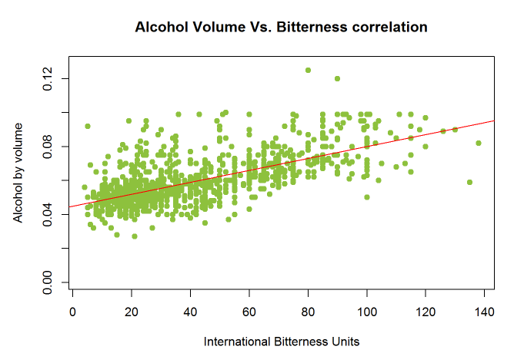
Bitter Booze relationship
There is moderate correlation between the bitterness and the alcohol volume
IBU’s explains ~45% of the variability in ABV. Perhaps accounting for beer styles would help explain more of the variability in ABV
The upward trend line from the regression analysis supports the findings

Slide 7
Data Considerations
Have identified the following data conditions:
82 Beer Names from the Beers dataset are duplicates with different Beer ID
Operated under the assumption that these truly represented different styles/years of the same beer
7 names of Breweries are duplicates, some are from different cities
Assume these are same breweries from different locations since they have distinct IDs
Missing Data:
69 records are missing details of ABV – Alcohol By Volume &
1005 records with missing IBU – International Bitterness Unit details

Slide 8
Conclusions
There is wide variability in Style, Volume, IBU and ABV by state and region, it could be an indicative of the preference from those regions.
Overall there is a moderate positive relationship between IBU & ABV in the US craft beer market.
Could better understand the relationship between IBU and ABV by accounting various beer styles although that is outside the scope of this analysis

Slide 9
Glossary
IBU – International Bitterness Unit
Measured as part per million of isohumulone found. It starts at 0 and open ended at the top. Standard Budweiser has 7 IBU & average IPA between 40-60. Double IPAs are ranging from 60-100.
ABV – Alcohol by Volume
This tells us what percentage of the beer is alcohol. Samuel Adams Utopias 24ounce boasts an ABV of 27%, typical Vodka has 40% ABV
R Packages used: fiftystater, RColorBrewer, Shiny , RCurl, dplyr & ggplot2,
Codebase & technical analysis details can be found in: https://github.com/nateewall/MSDS6306_CaseStudy1

